Slide 1

IBM DATA SCIENCE PROFESSIONAL CERTIFICATE
FALCON 9 LANDING PREDICTION CAPSTONE
Comprehensive Data Science Report & Final Deliverables
Prepared by: Data Science Candidate Submission Date: May 2026

Slide 2





FINAL PROJECT DELIVERABLES
GITHUB REPOSITORY
PDF PRESENTATION
Complete source code, including all Jupyter Notebooks (.ipynb) and Python scripts (.py) for the data pipeline.
Final exported slide deck covering all methodology, insights, and predictive results for executive review.

Slide 3

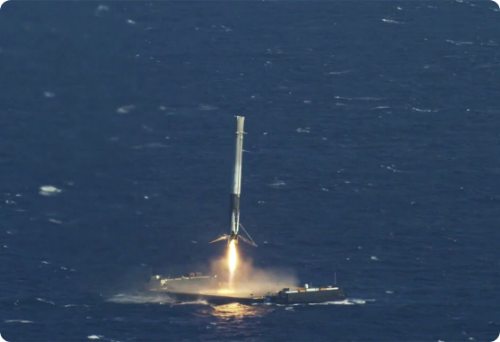
EXECUTIVE SUMMARY
Objective: Predict the successful landing of Falcon 9's first stage to determine launch costs and competitive advantages.
•
Data Pipeline: Integrated API extraction, Wikipedia scraping, and SQL-based EDA.
•
Key Findings: Success rates have improved by >300% since 2013, with KSC LC-39A as the top-performing site.
•
Model Selection: Decision Tree classifier achieved 83.3% accuracy, demonstrating high reliability for mission outcome prediction.

Slide 4
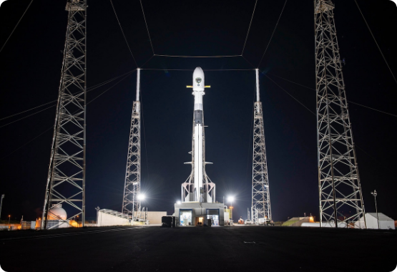
INTRODUCTION
THE COST OF SPACE TRAVEL
SpaceX advertises Falcon 9 launches at $62M, significantly lower than competitors (~$165M). This is possible through first-stage reusability.
Determining the probability of a successful landing is crucial for calculating the actual cost of a launch and outbidding competition.

Slide 5



METHODOLOGY: COLLECTION & WRANGLING
SPACEX REST API
WEB SCRAPING
DATA WRANGLING
Extracted real-time structured data for Falcon 9 launches using the /launches endpoint and normalized nested JSON into flat DataFrames.
Utilized BeautifulSoup to parse Wikipedia tables, capturing historical mission data not available through the standard API.
Cleaned null values (imputed payload mass), filtered out Falcon 1 records, and converted landing outcomes into binary success/failure classes.

Slide 6
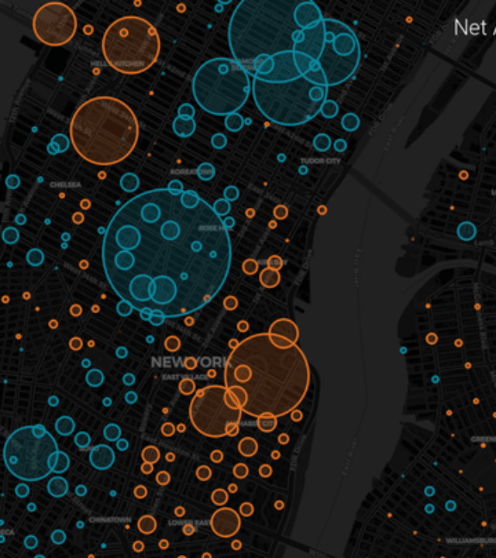
EDA & INTERACTIVE ANALYTICS
ANALYTICAL TOOLKIT
SQL Analysis: Leveraged sqlite3 to perform complex queries on booster reliability and payload trends.
Interactive Visualization: Used Folium for geospatial site proximity and Plotly Dash for real-time dashboard analytics.
Statistical Charts: Matplotlib and Seaborn were used to identify correlations between payload, flight number, and orbit type.

Slide 7
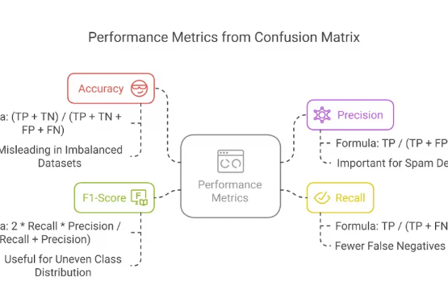
METHODOLOGY: PREDICTIVE ANALYSIS
CLASSIFICATION PIPELINE
The predictive phase involved feature standardization followed by the evaluation of four key algorithms:
•
Logistic Regression: Baseline classifier.
•
SVM: High-dimensional boundary optimization.
•
Decision Tree: Rule-based interpretability.
•
K-Nearest Neighbors: Instance-based learning.
Tuning: Utilized GridSearchCV for hyperparameter optimization across all models.

Slide 8

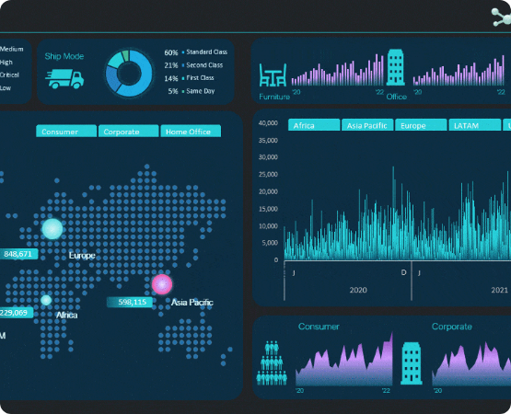
EDA RESULTS: VISUAL INSIGHTS
KEY OBSERVATIONS
1. Payload vs Launch Site: KSC LC-39A shows high success rates for heavy payloads (>10,000 kg).
2. Success vs Orbit: SSO, HEO, and GEO orbits show 100% success rates, while GTO is highly variable.
3. Yearly Trend: Success rates have stabilized above 80% since the introduction of Block 5 boosters in 2018.

Slide 9
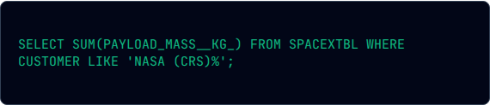
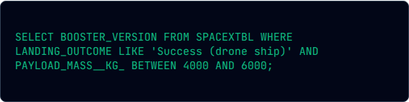
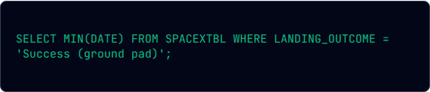
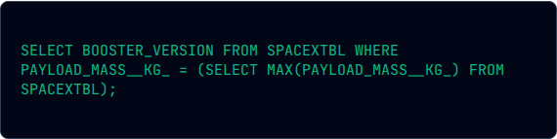
EDA RESULTS: SQL STRUCTURED INSIGHTS
-- Task 3: NASA CRS Payload --
-- Task 6: Boosters with Payload 4k-6k --
Result: 45,596 kg
Result: F9 v1.1 B1022, B1026...
-- Task 5: First Successful Ground Landing --
-- Task 8: Maximum Payload Boosters --
Result: 2015-12-22
Result: F9 B5 B1048.4, B1049.4...
SQL queries enabled the extraction of precise business metrics and mission records from the landing dataset.

Slide 10
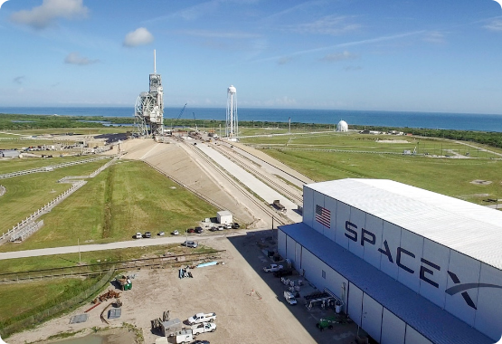
INTERACTIVE ANALYSIS: FOLIUM PROXIMITY
GEOSPATIAL SAFETY & LOGISTICS
We mapped launch sites (CCAFS, KSC, VAFB) to analyze their distance to critical features:
•
Coastline: Sites are intentionally located near the ocean (~1 km) for debris safety and drone ship landing paths.
•
Infrastructure: Sites are clustered near railways and highways to facilitate large-scale component transport.
•
Cities: Significant distance (~20+ km) is maintained from major urban centers.

Slide 11


INTERACTIVE ANALYTICS: PLOTLY DASH
DASHBOARD FEATURES
Success Rate Insight by Site
1. Dropdown Filter: Toggle between all sites or specific launch pads.
Site Name | Success Rate | Primary Orbit
KSC LC-39A | 76.9% | ISS / GTO
CCAFS SLC-40 | 42.9% | LEO
VAFB SLC-4E | 40.0% | Polar
2. Payload Slider: Filter success rates by specific payload ranges (0-10,000 kg).
3. Dynamic Pie: Instant visualization of Success vs. Failure ratio.

Slide 12


PREDICTIVE ANALYSIS: RESULTS
83.3%
83.3%
83.3%
83.3%
LOG REGRESSION
SVM ACCURACY
DECISION TREE
KNN ACCURACY
Outcome: All models converged on an 83.3% test accuracy. The Decision Tree is selected as the optimal model for its balance of accuracy and ability to interpret specific features like Payload Mass and Flight Number impact.

Slide 13

CONCLUSION & INNOVATIVE INSIGHTS
FINAL VERDICT
SpaceX's strategy of incremental improvement is evident in the data. Landing success is no longer a "lucky" event but a predictable engineering outcome.
Innovative Insight: Payload mass between 2,000-4,000 kg shows the highest success stability, suggesting that lighter missions are safer for landing testing than maximum-capacity missions.

Slide 14

QUESTIONS?
Thank you for your attention.
Final Submission - Data Science Capstone Project
Contact: candidate@datascience.edu | github.com/username

Slide 15






IMAGE SOURCES
https://i.ytimg.com/vi/TthLhqq4JUs/maxresdefault.jpg
Source: www.youtube.com
https://media.defense.gov/2020/Jun/29/2002333926/1200/1200/0/200628-F-ZZ999-103.JPG
Source: www.losangeles.spaceforce.mil
https://miro.medium.com/1*yVXW3w8fTjc6O8oFxstakA.gif
Source: blog.prototypr.io
http://www.mygreatlearning.com/blog/wp-content/uploads/2020/03/performance-confusuon-matrix-1024x568.webp
Source: www.mygreatlearning.com
https://d13ot9o61jdzpp.cloudfront.net/images/dark_theme_db.gif
Source: www.myonlinetraininghub.com
https://cdn-imgix.headout.com/media/images/2402f0f7f2f424f93ef90d1c1421c8fd-LE%2039A.jpg?auto=compress%2Cformat&w=1222.3999999999999&h=687.6&q=90&ar=16%3A9&crop=faces&fit=crop
Source: www.kennedyspacecenter-tickets.com

